Slide 1
Random variables and Statistical measures
A random variable is a numerical outcome of a random process or event.
It's a function that maps possible outcomes from a random event (the sample space) to real numbers.
For example, when rolling a die, the possible outcomes are {1, 2, 3, 4, 5, 6}, and the random variable can simply represent the number on the face of the die.

Slide 2
Statistical Measures
Statistical measures describe the characteristics of a random variable's probability distribution.

Slide 3
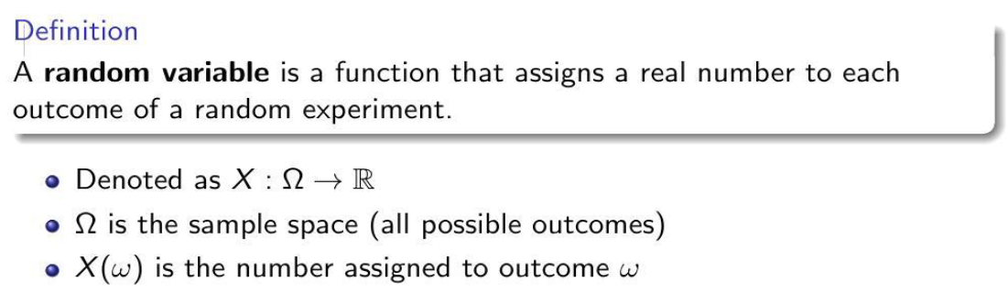
RANDOM VARIABLE

Slide 4
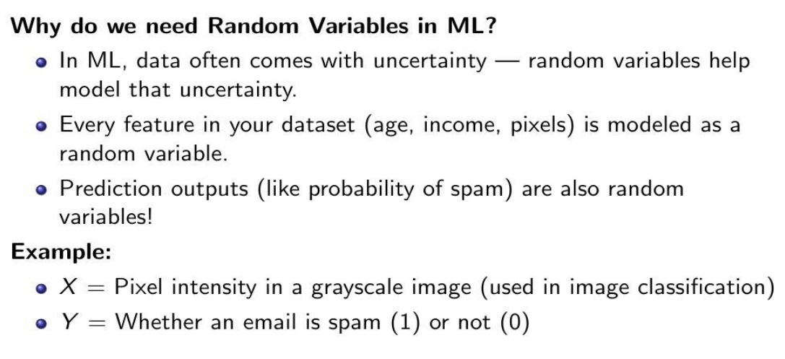

Slide 5
Types of Random Variables
Discrete Random Variables
These can only take a finite number of values or an infinite sequence of values.
Example: The number of defective items in a batch of products.
Continuous Random Variables
These can take on any value within a given range or interval.
Example: The weight of a randomly selected person, which can be any value within a range of weights.

Slide 6
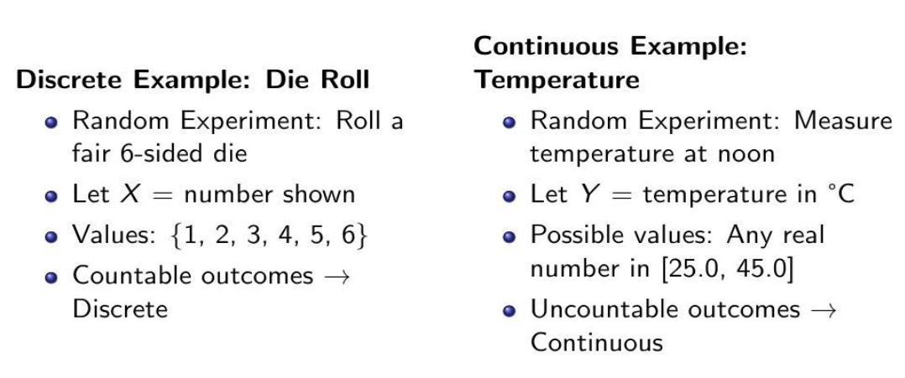

Slide 7
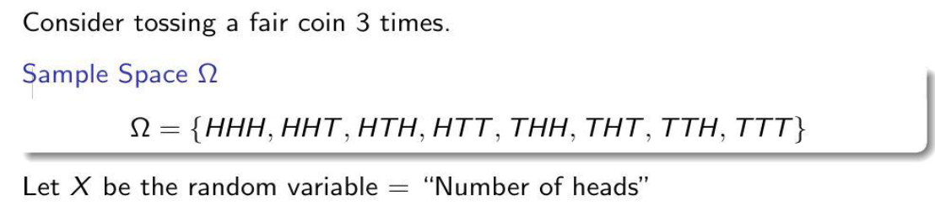
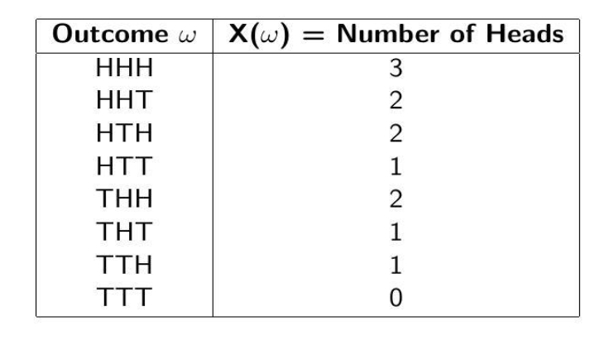
RANDOM VARIABLE EXAMPLE
PROBABILITY OF THE RANDOM VARIABLE ‘X’
    P(X=0)=1/8
    P(X=1)=3/8
    P(X=2)=3/8
    P(X=3)=1/8

Slide 8

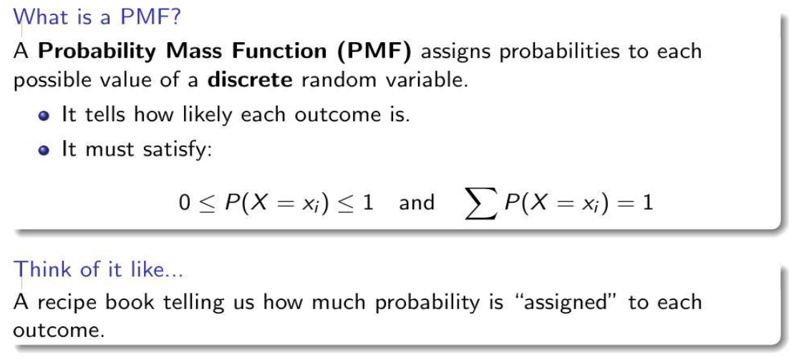
Probability Mass Function(PMF)

Slide 9
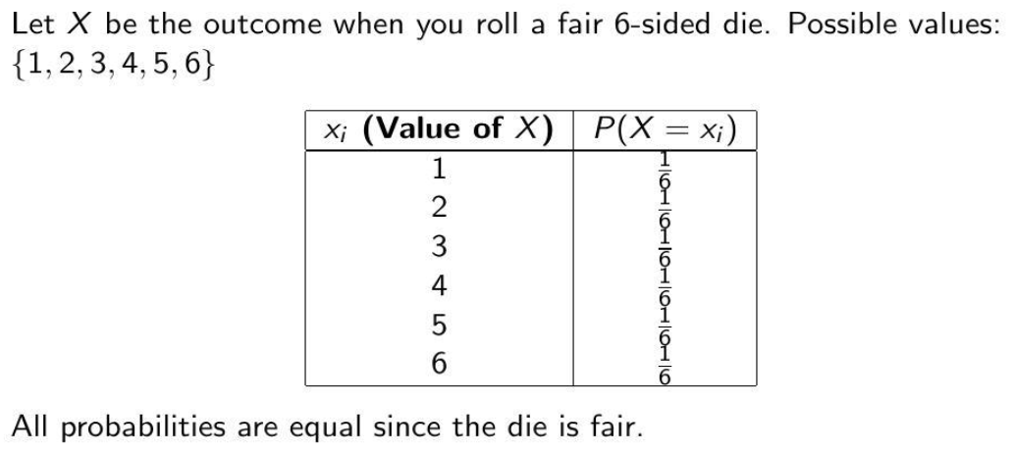
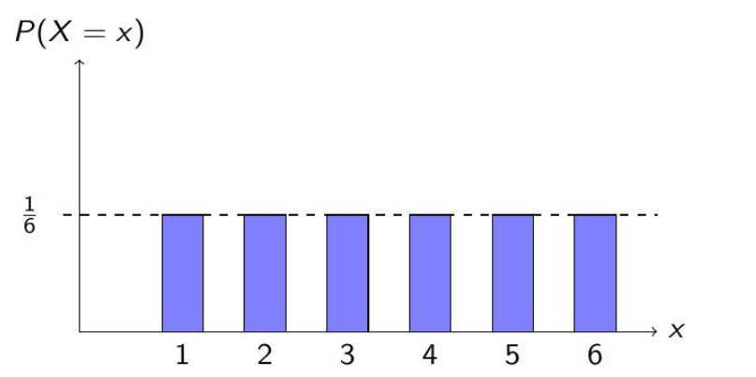

Slide 10
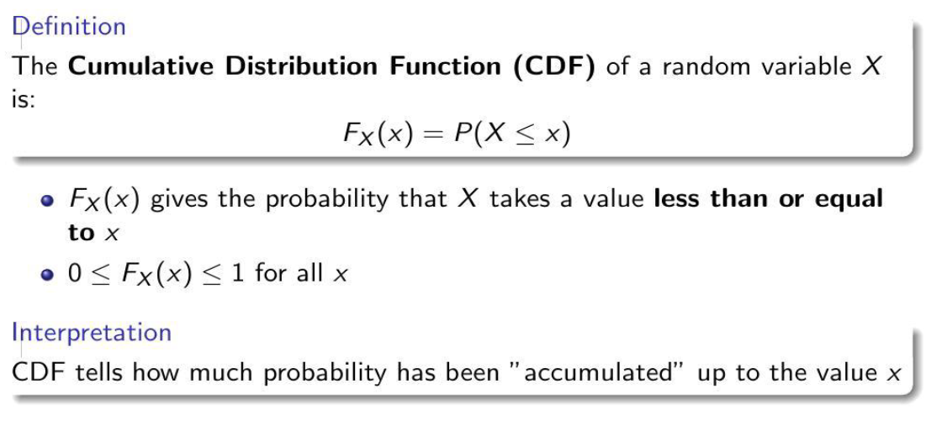

Slide 11
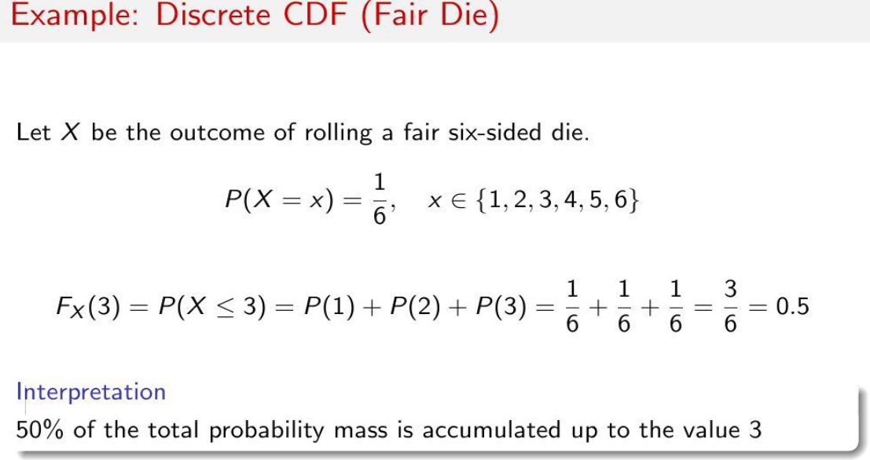

Slide 12
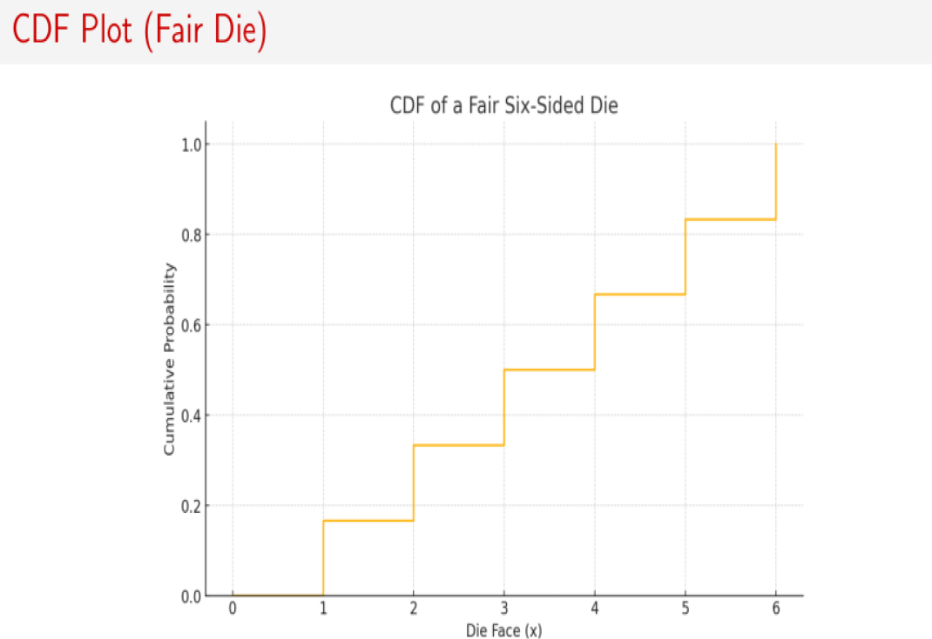

Slide 13
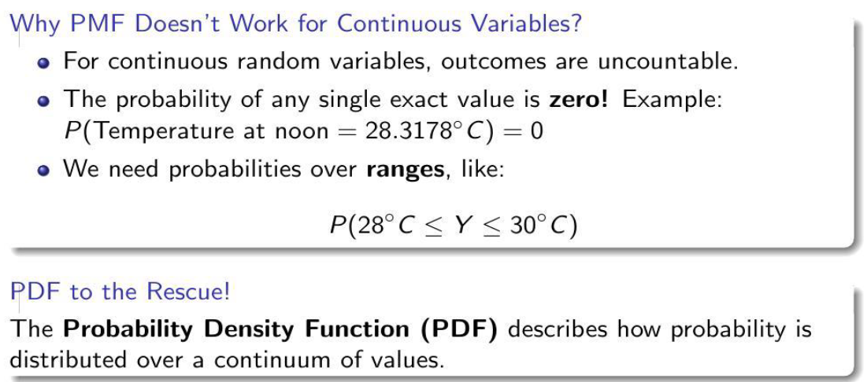

Slide 14
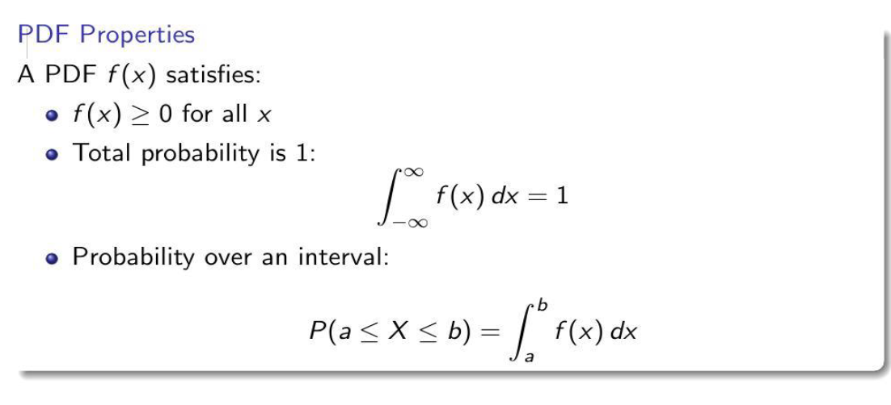

Slide 15
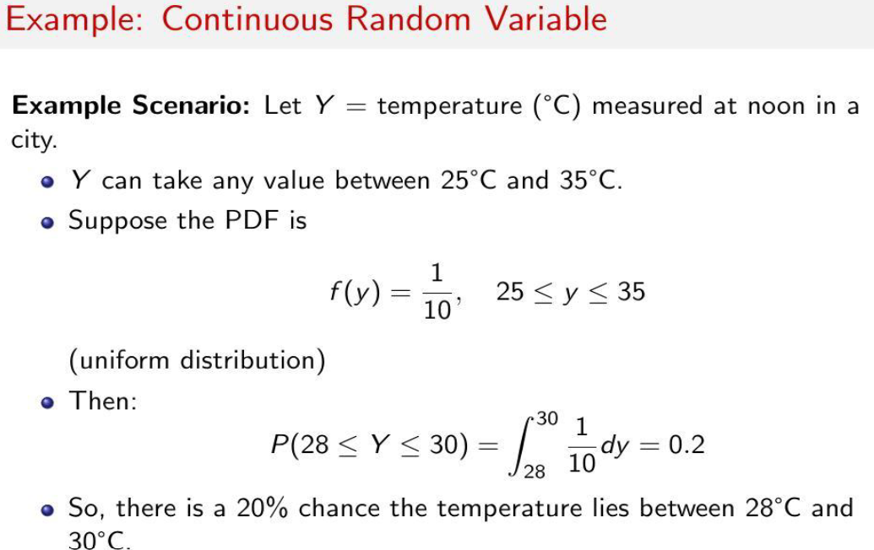

Slide 16
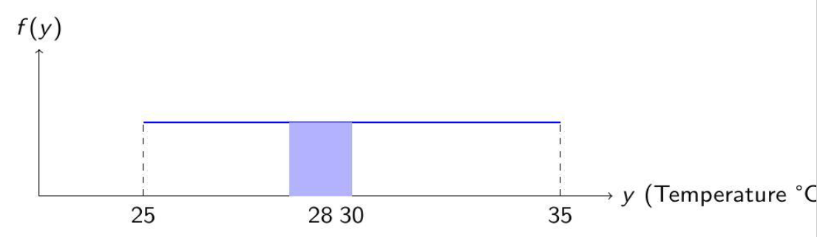
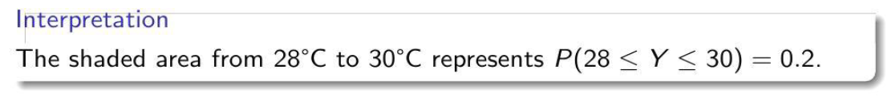
PDF

Slide 17
Statistical measures
Statistical measures are numerical values that describe key characteristics of a dataset, including measures of central tendency (like the mean, median, and mode) which summarize the center of the data.
and measures of dispersion (such as range, variance, and standard deviation) which describe the spread or variability of the data.
Together, these measures provide a concise summary of a dataset's properties.

Slide 18

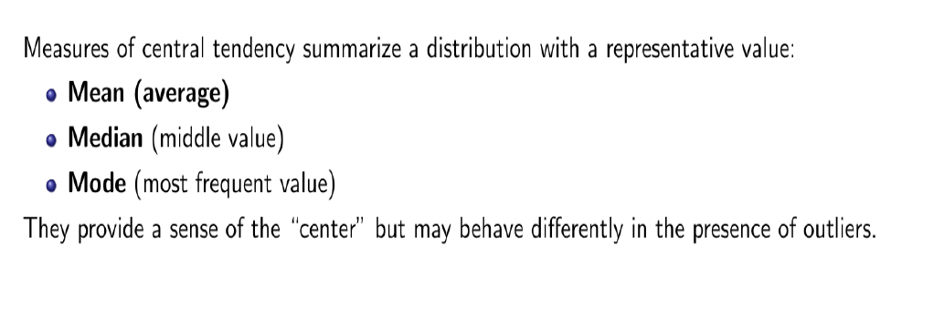

Slide 19
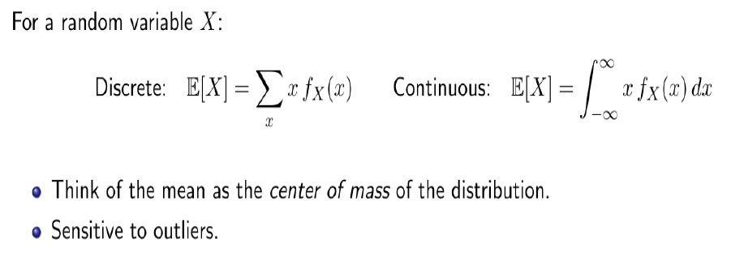
MEAN/EXPECTED VALUE OF A RANDOM VARIABLE

Slide 20
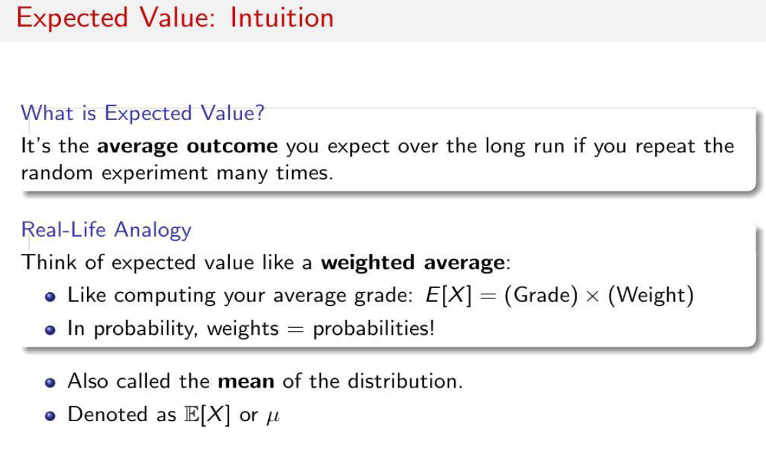

Slide 21
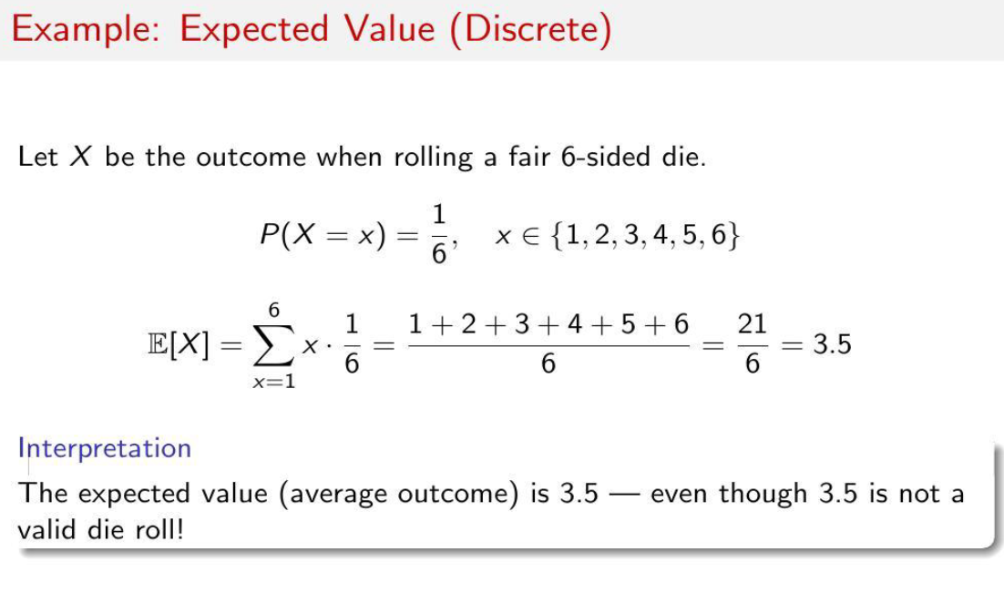

Slide 22
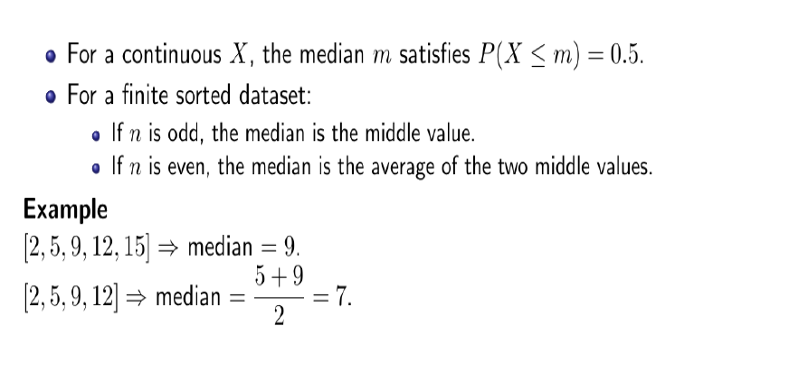
MEDIAN

Slide 23
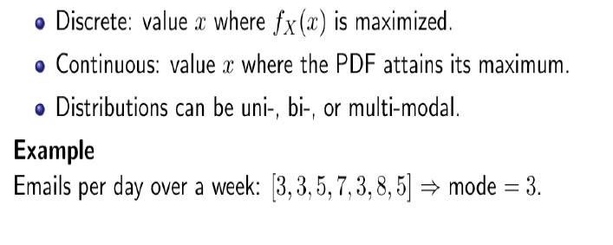
MODE

Slide 24
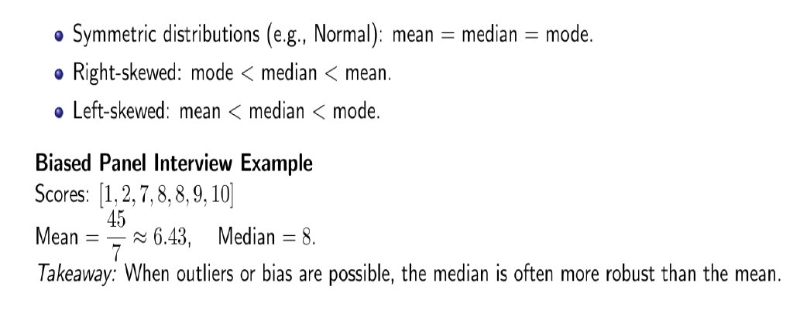

Slide 25
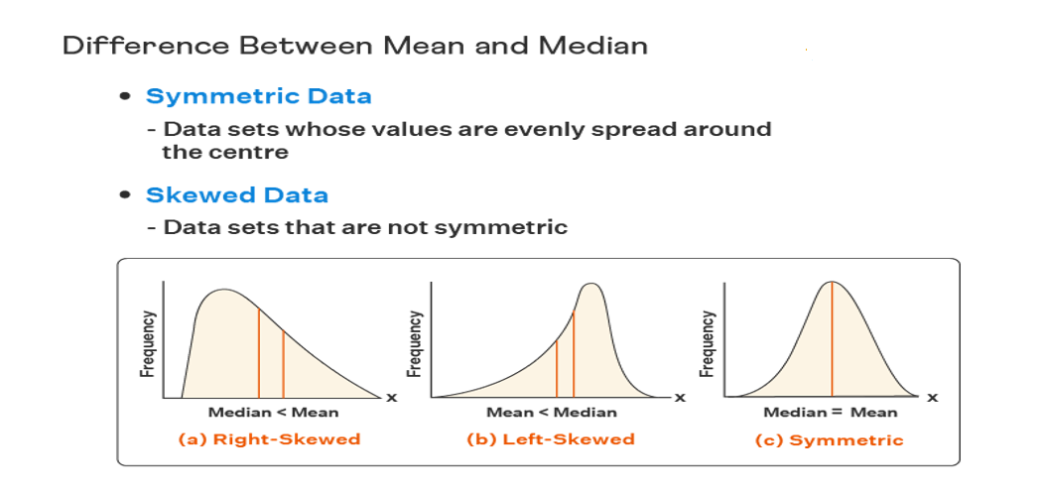

Slide 26
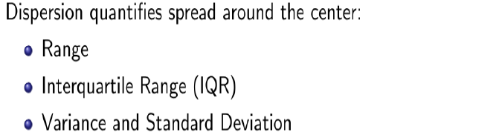
Measures Of Dispersion

Slide 27
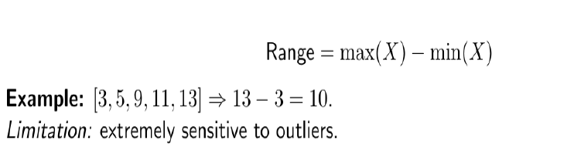
Range

Slide 28
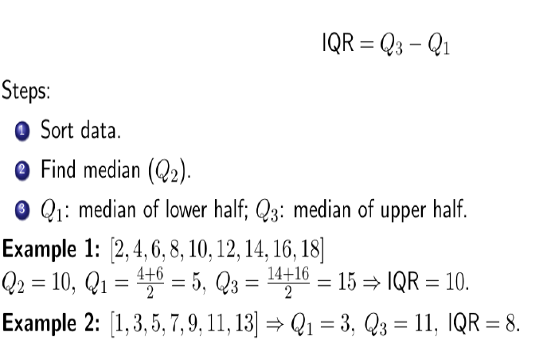
Interquartile Range(IQR)

Slide 29
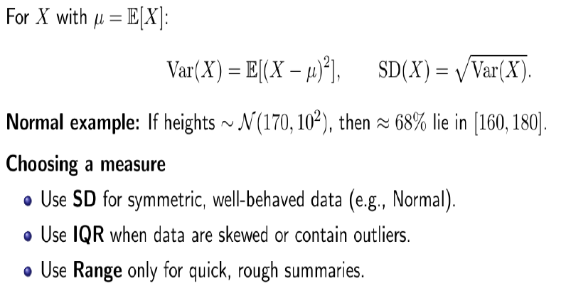
Variance and Standard Deviation

Slide 30
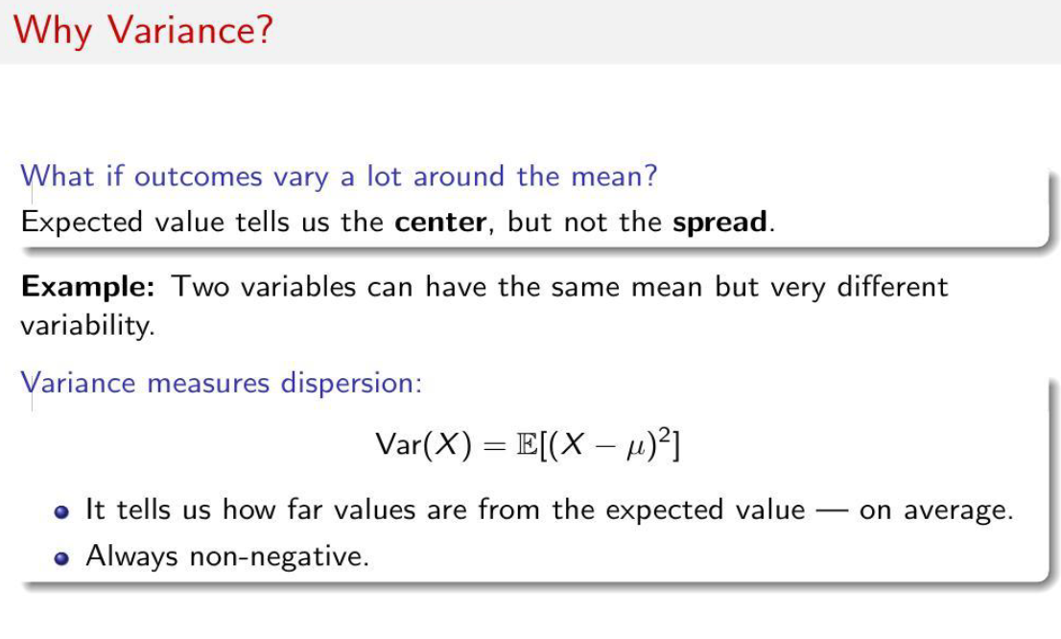

Slide 31
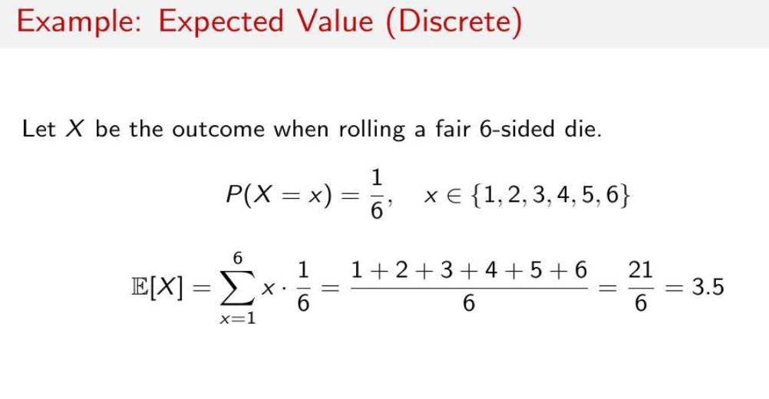

Slide 32
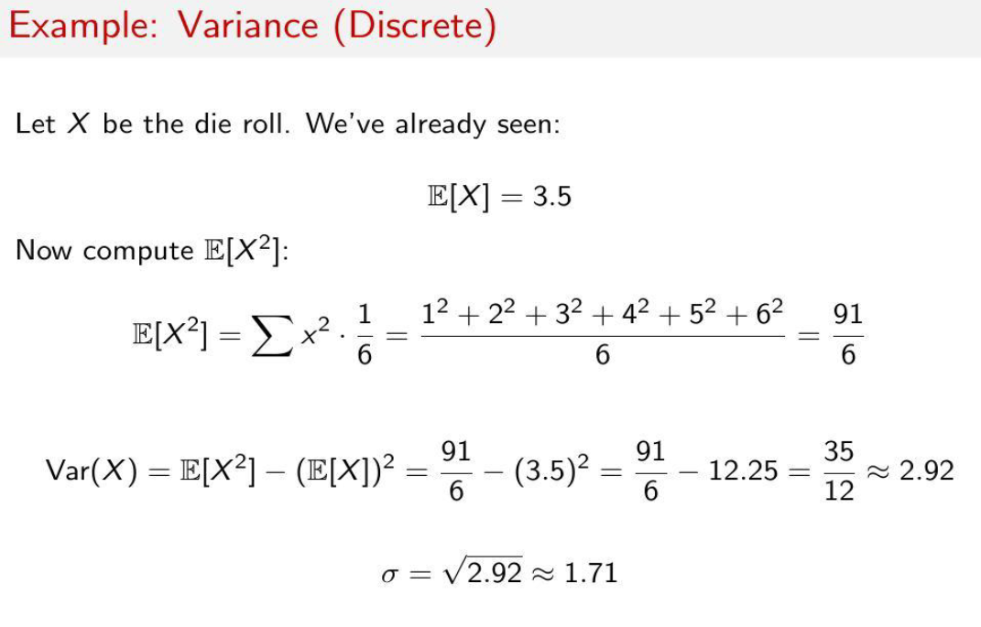

Slide 33
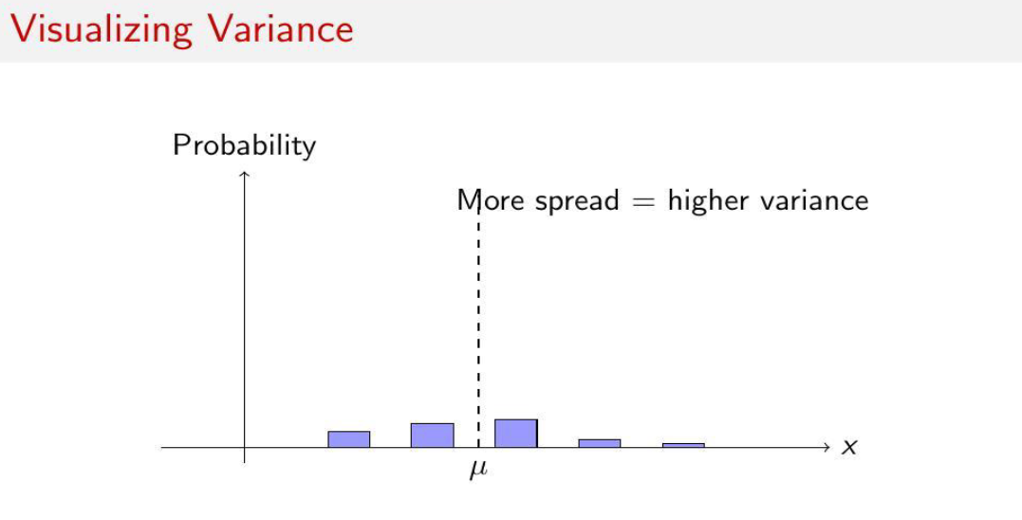
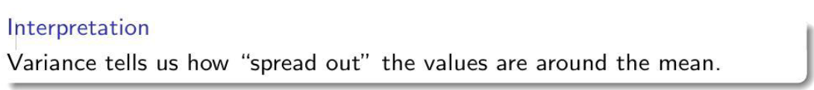

Slide 34
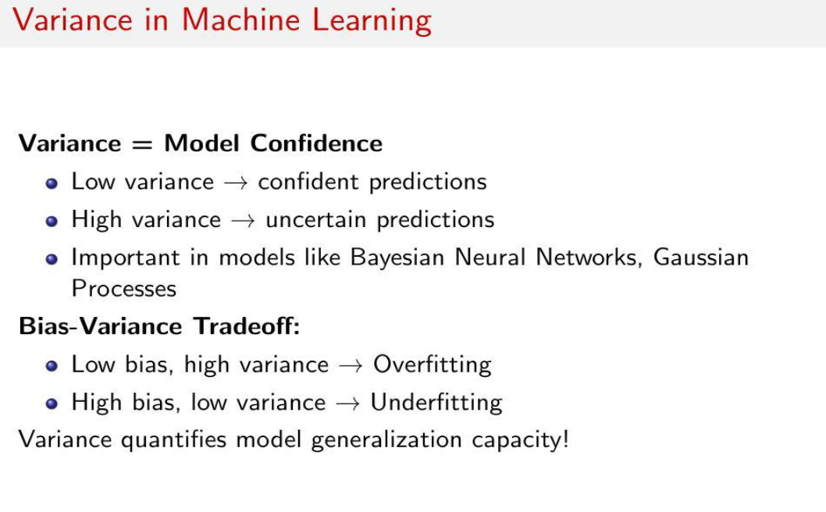

Slide 35
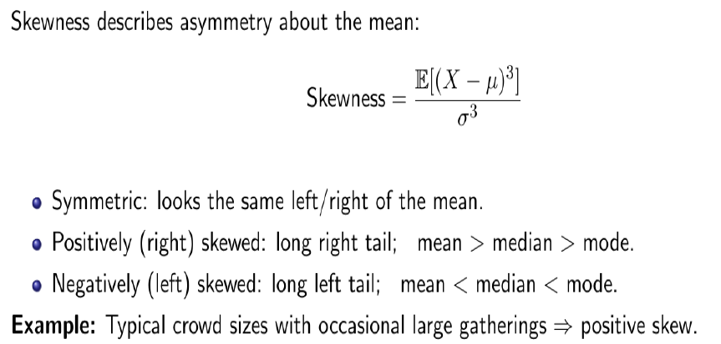
Skewness

Slide 36
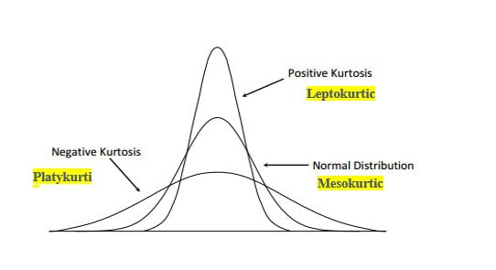
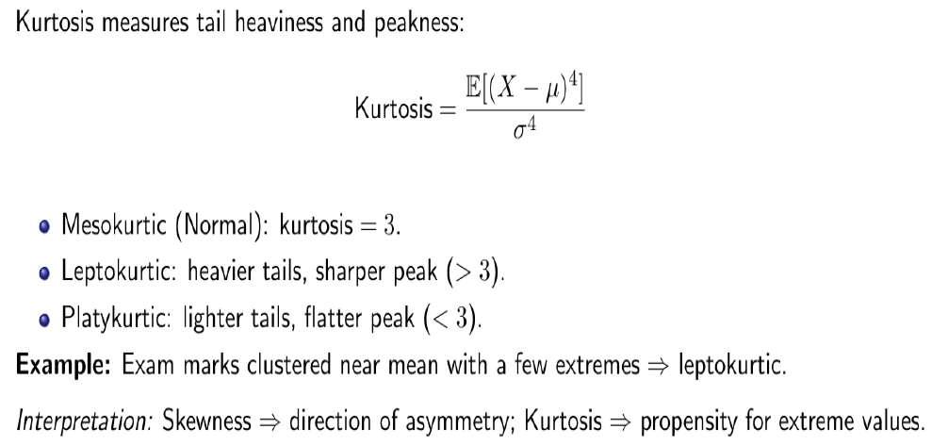
Kurtosis

Slide 37
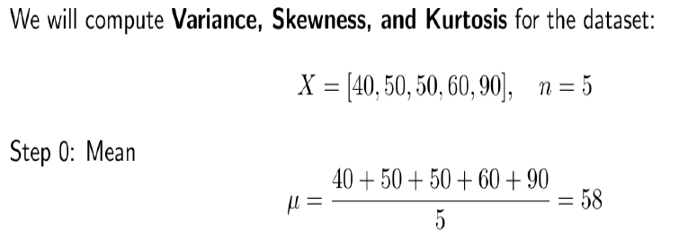
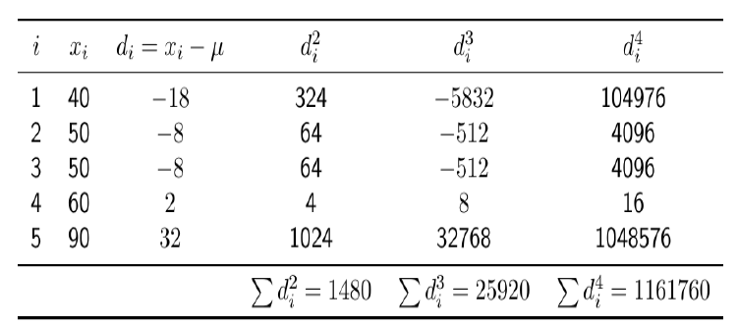
Example: Dataset given

Slide 38

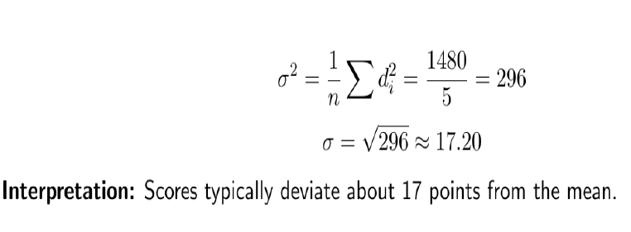

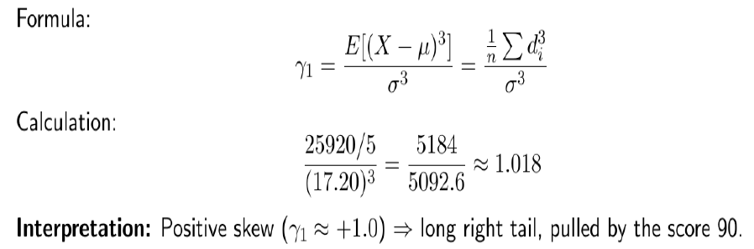

Slide 39

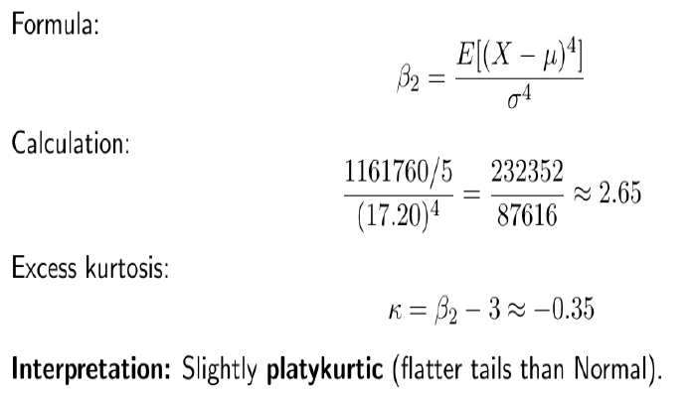

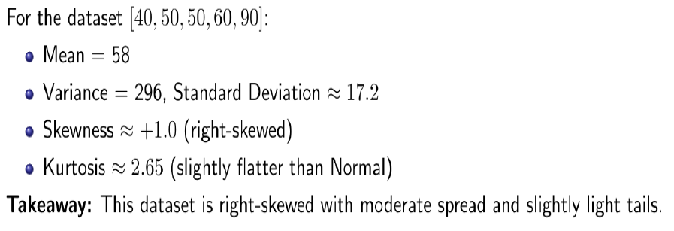

Slide 40
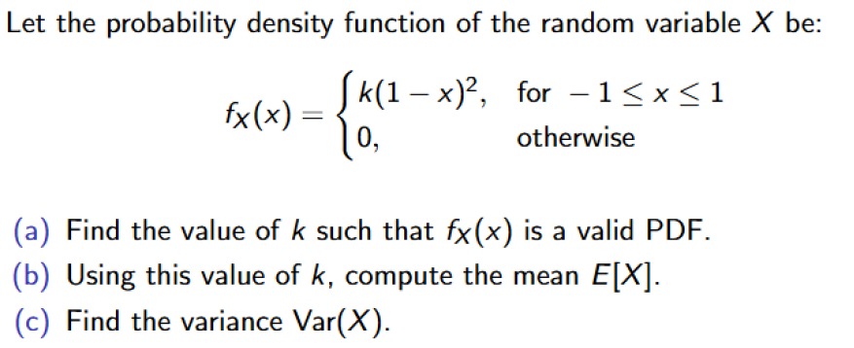
Example - PDF

Slide 41
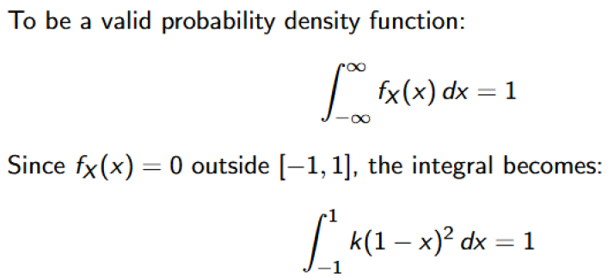

Slide 42
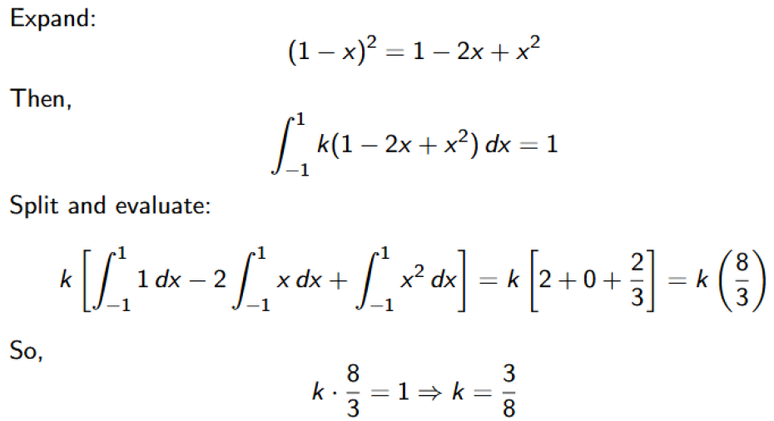

Slide 43
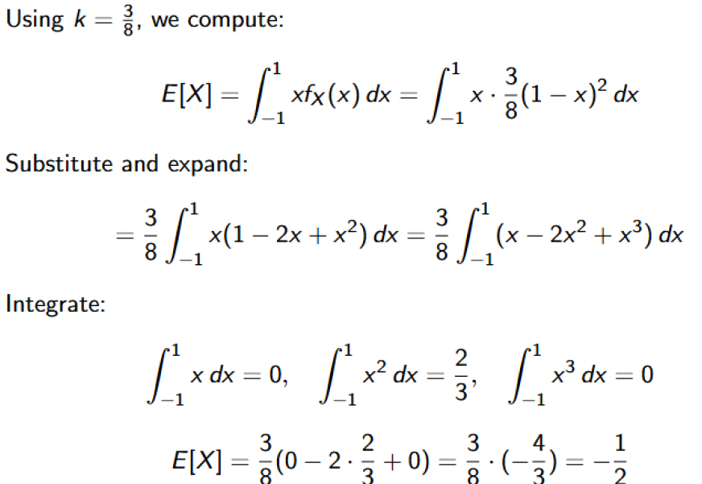

Slide 44
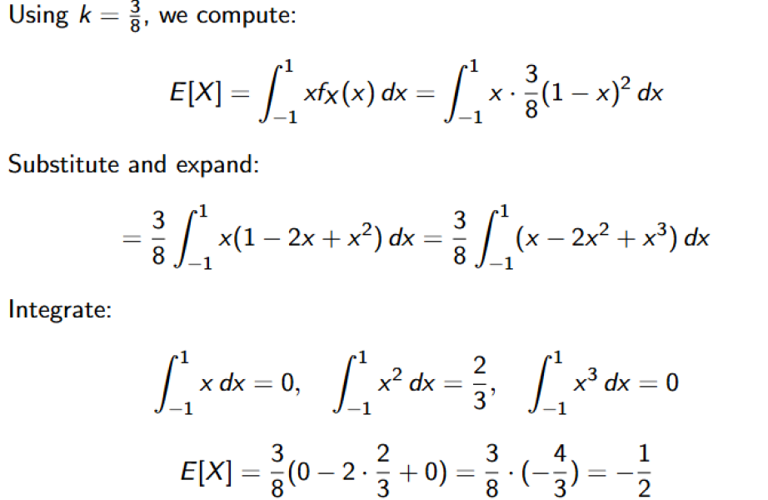

Slide 45
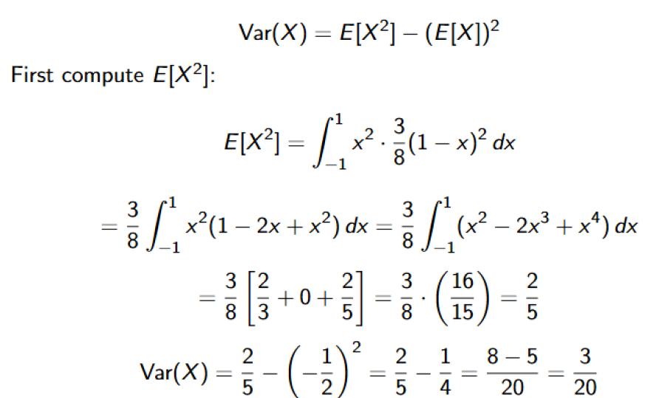

Slide 46
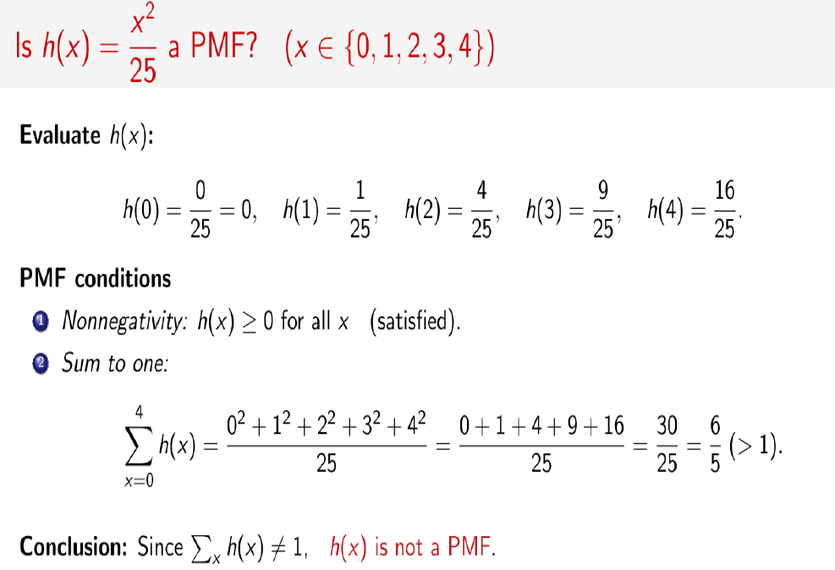

Slide 47


Slide 48


